Slide 1

GNOME 3
11.4
Released 10th of March 2011
and
openSUSE
Notes:
Hi there! My name is XXXX and I will tell you all a bit about the latest & greatest from the openSUSE Community, openSUSE 11.4!

Slide 2
LibreOffice
Scribus 1.4
Firefox 4
GNOME
KDE SC 4.6
3
2
and
Notes:
This release came out in the beginning of March. First to ship a stable LibreOffice in a major distro release; the same with Firefox 4.0, Scribus 1.4 and KDE SC 4.6. Our 8 month release schedule ensures we have stable software but we also ship the latest where needed!

Slide 3
Tumbling
and
Rolling
YOUR
own
build
.
.
.
Notes:
We also introduced Tumbleweed, a rolling release on top of openSUSE.
Packman has updated their repository layout and of course you can use 11.4 from SUSE Studio!

Slide 4
Deeper
Down
systemd
Kernel 2.6.37
Zypper
ATI/NVIDIA
YaST Encryption
Notes:
Zypper package management super fast: downloads 'delta' (difference between old and new package) from different servers at same time!
YaST can handle fully encrypted system during installation
Kernel 2.6.37 supports Broadcom WIFI (many laptops have this chip) and there is better support for NVIDIA and AMD/ATI videocards.
Also, openSUSE has added some extra peformance patches to the kernel.
11.4 starts up faster and includes experimental GRUB2 & systemd

Slide 5




CHOICE
is
GOOD
Notes:
Let's begin by talking about desktop.
openSUSE believes choice and flexibility are good. So while we try to keep things as easy as possible, we don't go any further than that. Keep the default or adapt it to your personal needs.
We ship 4 major desktops products: KDE's Plasma desktop and netbook, GNOME, XFCE and LXDE. Pick!

Slide 6
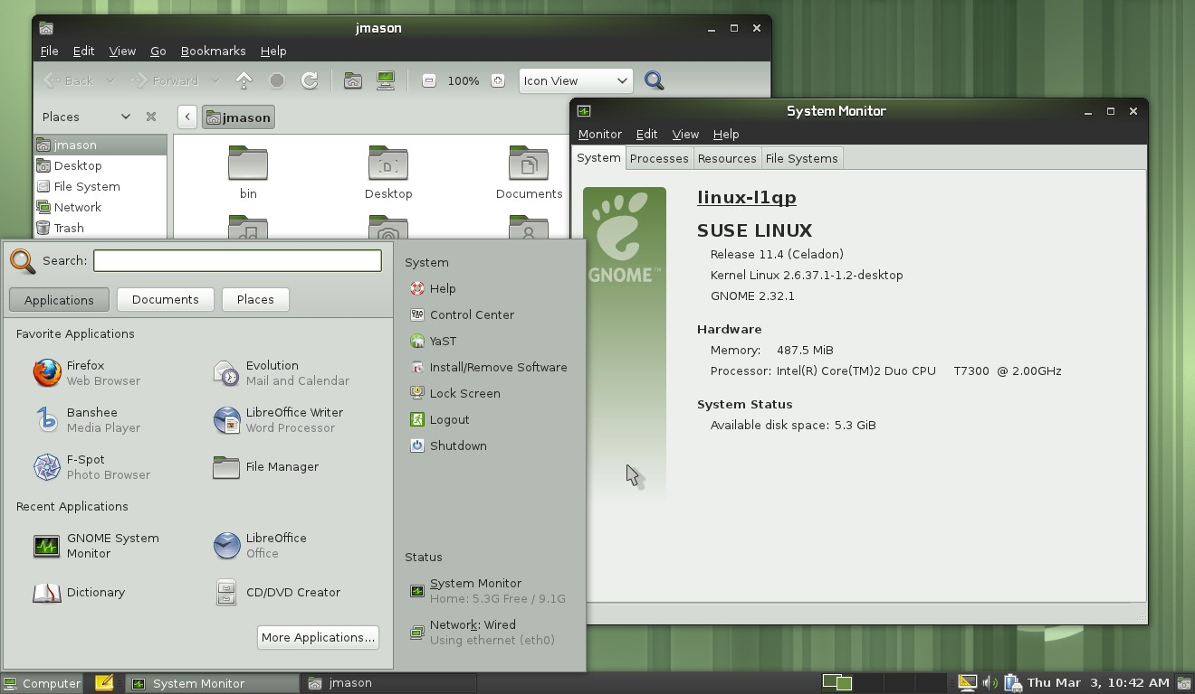
Last in the 2.32 series
Notes:
The default GNOME in openSUSE 11.4 is GNOME 2.32, the last release in the GNOME 2.x series. It is very stable and easy to use. Let's look at the biggest changes:

Slide 7
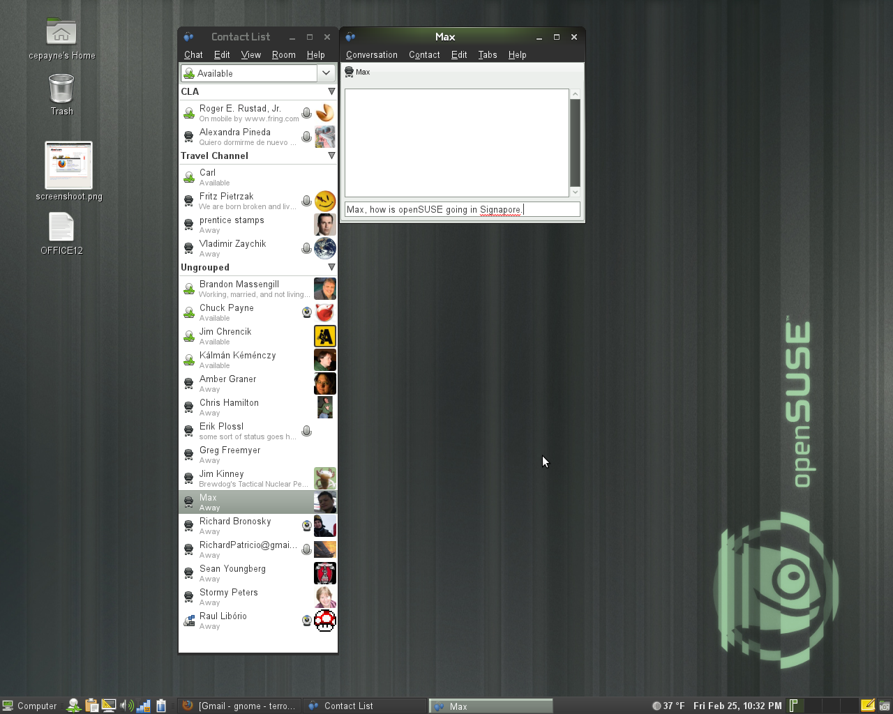
Notes:
- Updates to Empathy include user contact grouping with metacontacts, logging of chat records, and security certificate import.

Slide 8
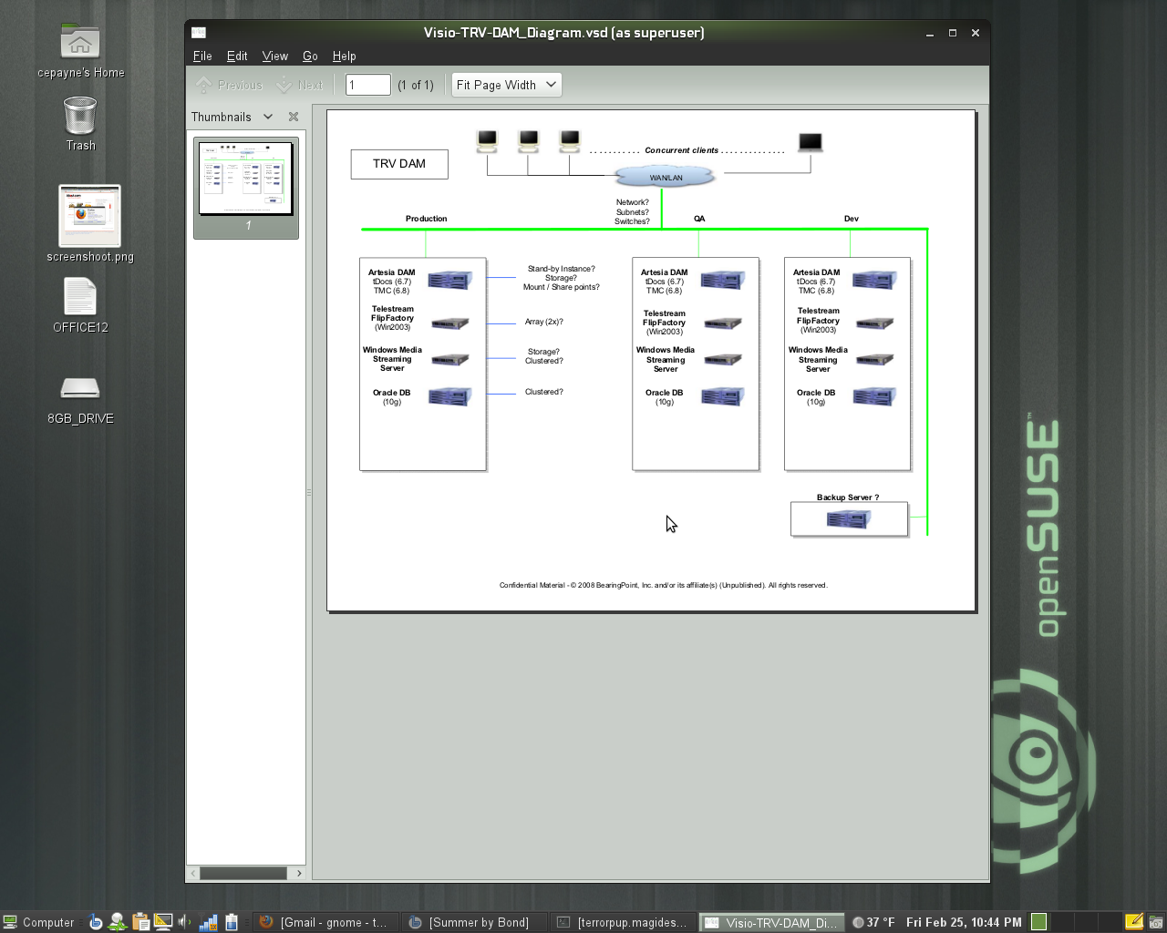
Notes:
- The Evince document viewer has improved accessibility support, maximum zoom level increased. Better Annotation support, add annotations from the side panel, change the default properties including author, color, transparency and more.
- Mousetweaks, which makes it easier to use a mouse for those users who may have limited mobility, has updated documentation

Slide 9
CHOICE
is
GOOD
Notes:
But there is a second GOME in openSUSE 11.4!
openSUSE ships with a pre-release of the upcoming GNOME 3.x Desktop (GNOME Shell)

Slide 10
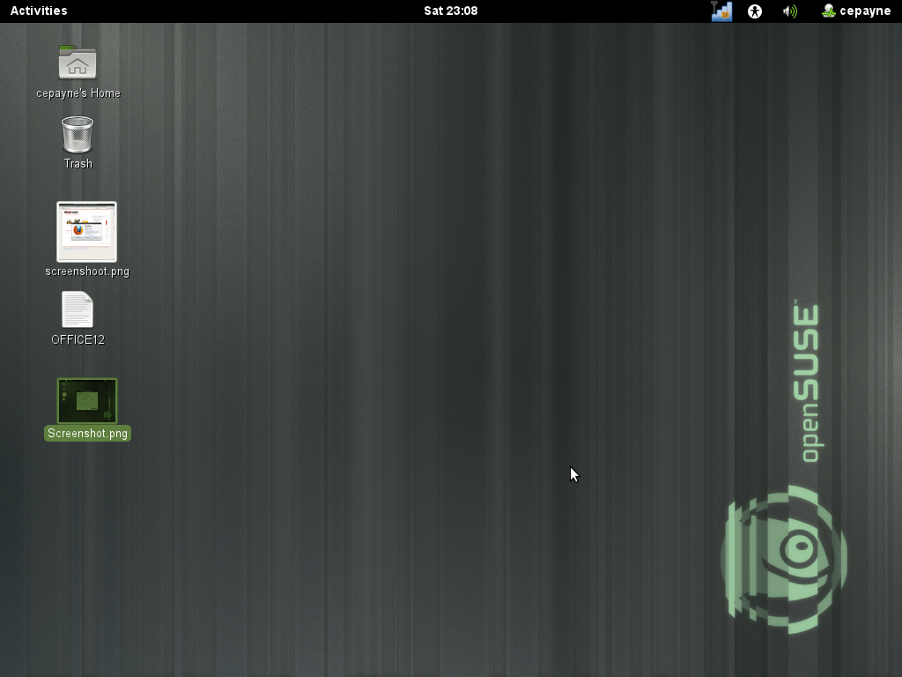
Notes:
GNOME Shell is the new face of GNOME. The goal of the project is to create a better design for the look and feel of the desktop and the key functions the desktop provides. These functions include enabling the user to find and open applications and documents, switch between various activities, and view incoming information such as chat messages or stock price updates.

Slide 11
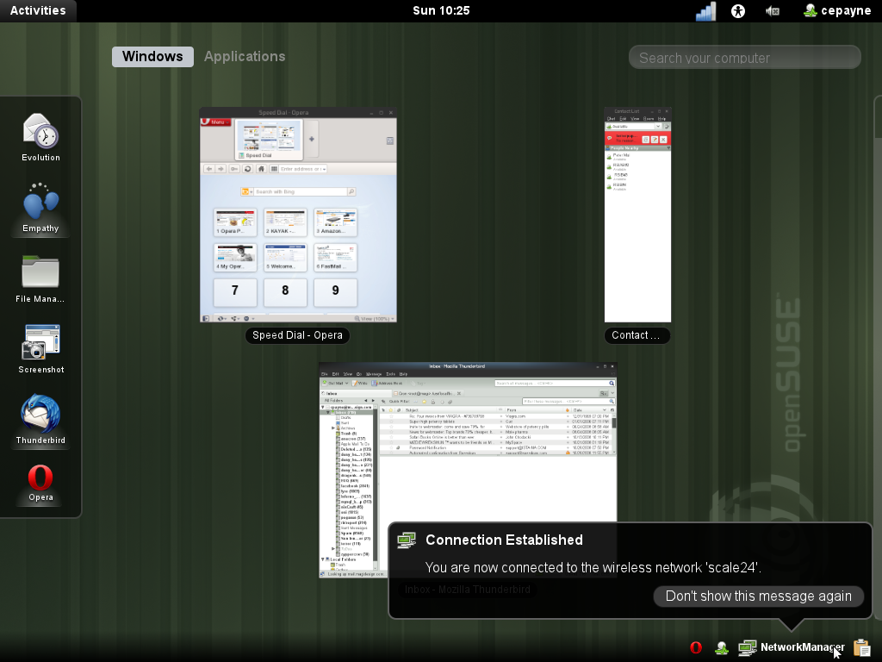
Notes:
If you click the 'Activities' button on the top left of GNOME Shell, you'll get this overview of your running applications.
You can start new apps by clicking them on the left or dragging them to a virtual desktop. Notifications are on the bottom right, as you see. You will be able to respond to things like chat there right away without starting a separate application!

Slide 12
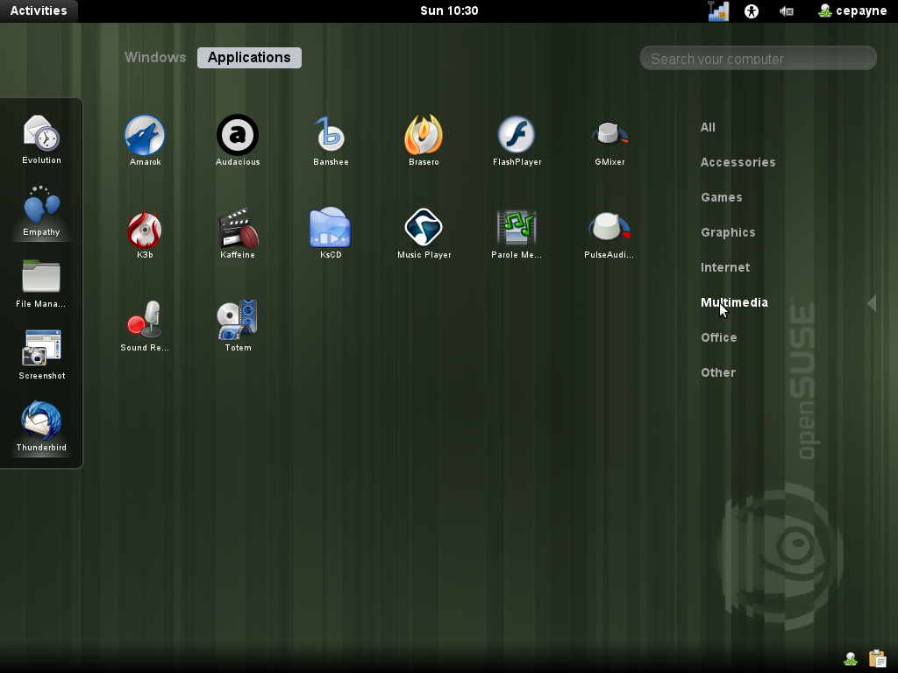
Notes:
If you use the search box you'll see GNOME Shell show you the apps you are looking for.

Slide 13
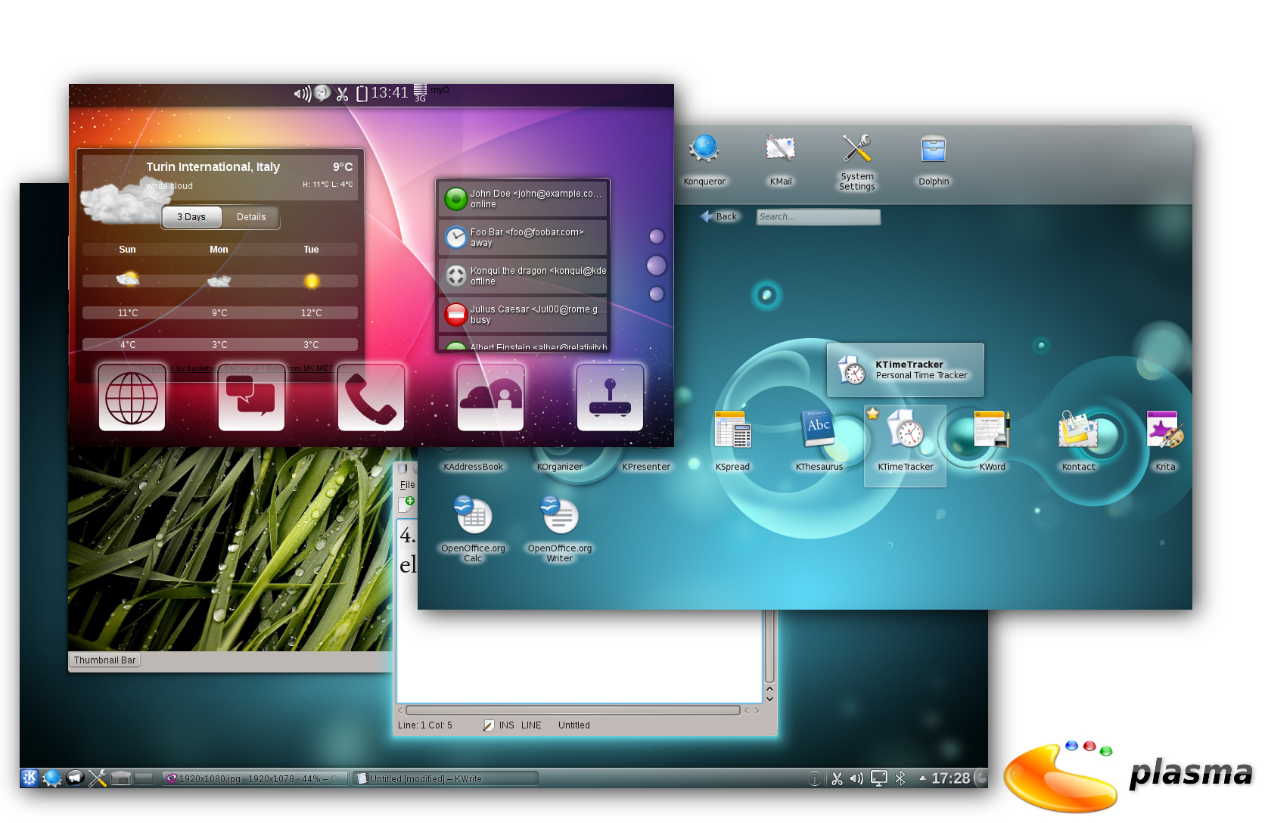
Plasma choices
Notes:
From KDE we ship the Plasma Desktop and Plasma Netbook Workspaces. Major changes are the introduction of Activities to help you manage your tasks easier, better search in dolphin, pinning of tasks to the taskbar for easy starting and easier accessible social sharing plugins like flickr and facebook.

Slide 14
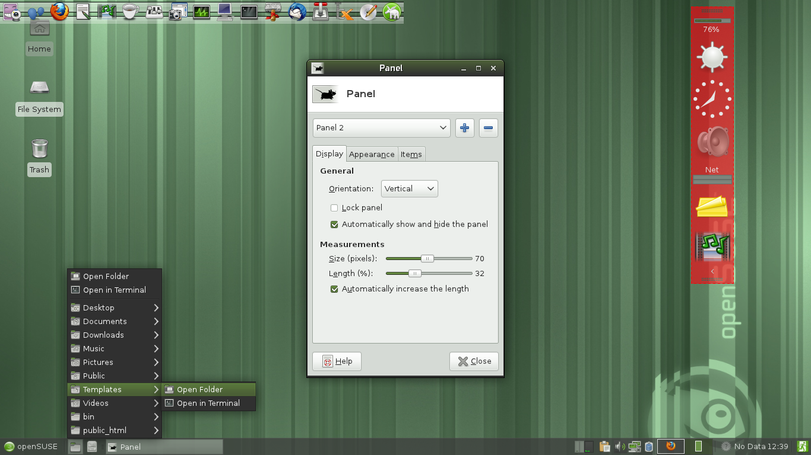
Notes:
We ship XFCE 4.8, which was years of work for the XFCE team
It offers a traditional but more configurable alternative
The new Panel is very flexible and easy to configure
Thunar can browse remote files and groups file dialogs.
OpenSUSE integration is excellent with improved shortcuts and file associations

Slide 15
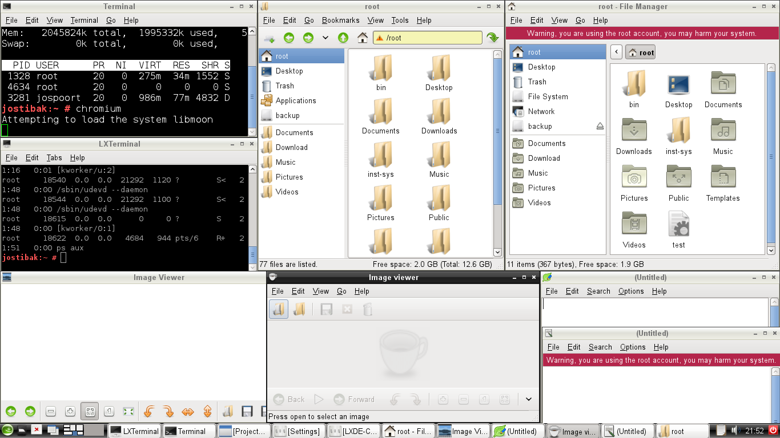
Notes:
LXDE aims to provide an extremely lightweight desktop, and succeeds on openSUSE 11.4. Booting in just 114MB of RAM, it provides a complete desktop experience without requiring modern hardware.
11.4 brings some small fixes and improved menu and file associations.

Slide 16
Applications
Ekiga
Inkscape
Ardour
Banshee
Cinerella
Amarok
LibreOffice
Gimp
K3B
Krita
Blender
Scribus
wine
Firefox
GNUcash
Thunderbird
Notes:
Let's go through some of the applications openSUSE 11.4 ships

Slide 17
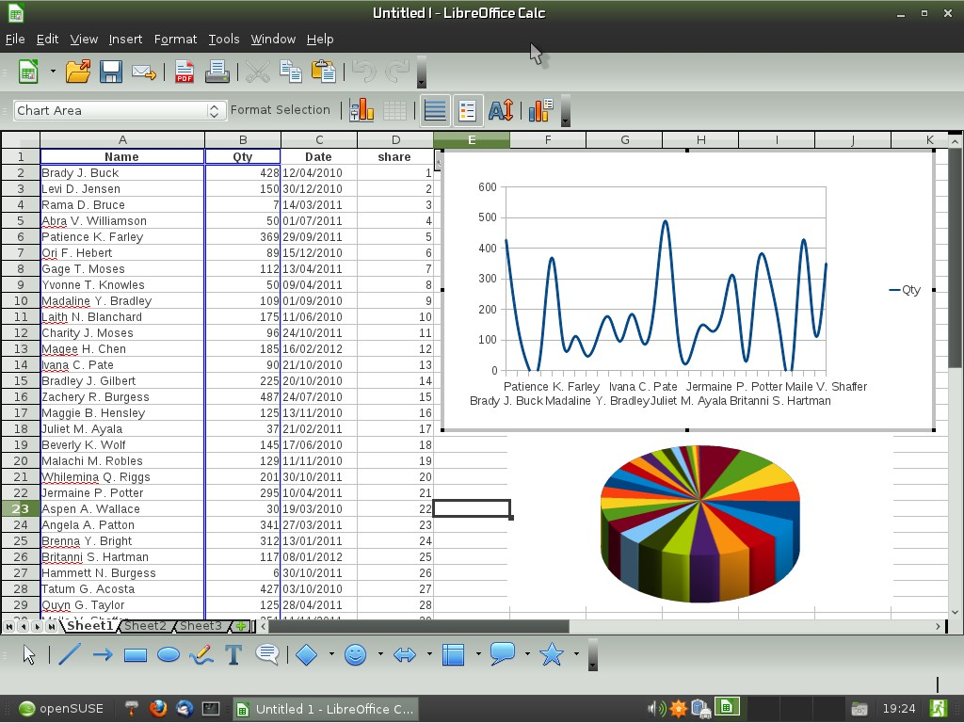
Notes:
LibreOffice 3.3.1 on XFCE 4.8 (SVG files in Draw, 1 million rows in Calc but real feature is community – Novell supports it heavily, openSUSE devs work on good integration!)
Koffice 2.3.1 Kpresenter: new slide sorter view and a shape animations tool. You can generate OpenDocument reports in KPlato and Kexi thanks to the KoReport library. OpenDocument support (esp text rendering) has been improved and also better support for reading MS files (doc, xls, ppt, docx, xlsx, pptx).

Slide 18
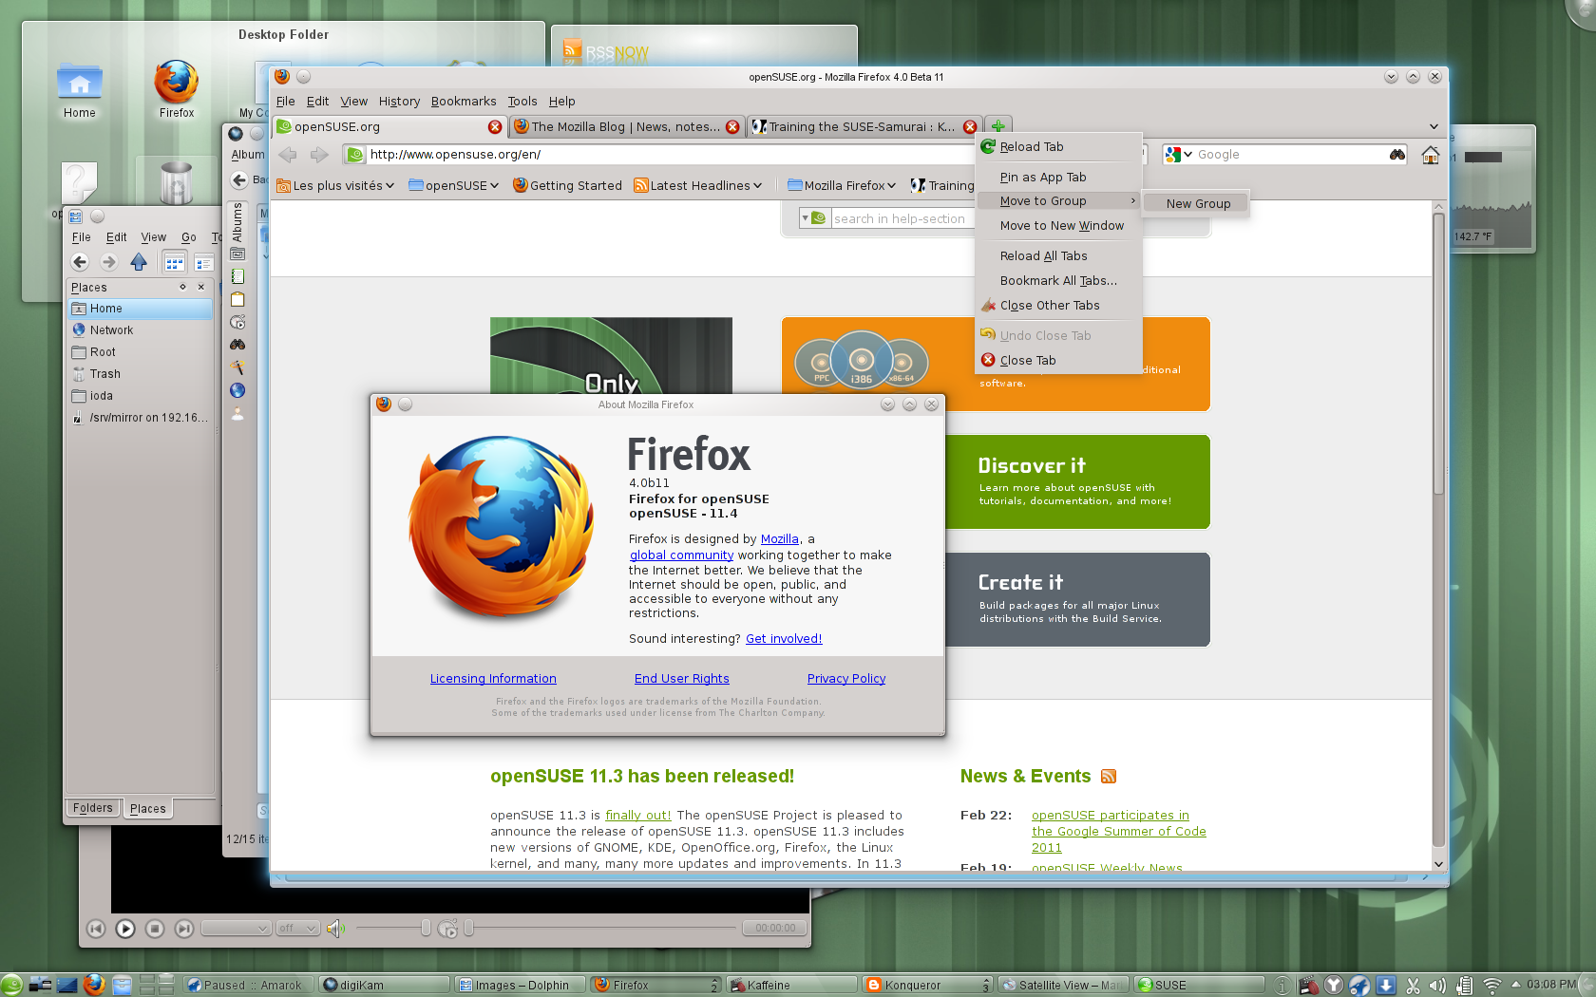
Notes:
Firefox 4.0 – new UI, better performance, Sync between Firefoxes
Other browsers – Google Chromium, Konqueror and ReKonq, Opera easy to install and others. Remember, choice!

Slide 19
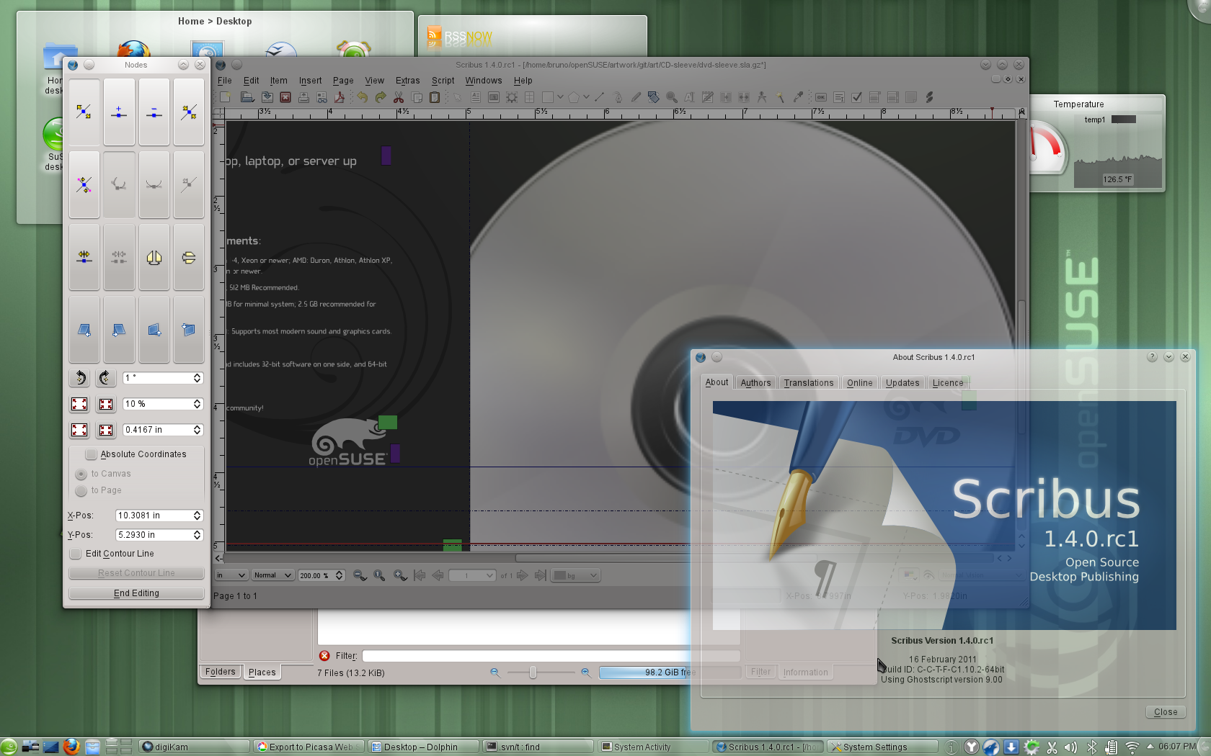
Notes:
Scribus 1.4.0 – Major rewrite, 1,5 year of work. Rewritten canvas (cairo), update to Qt4, usability.
Inkscape 0.48
* multipath editing
* improved text tool: subscript, superscript, numerical input for text kerning, tracking and more
* new Airbrush tool
* LaTeX export with PDF/PS/EPS
Krita 2.3 enduser ready. New features: brush settings presets, canvas rotation, warp transform, new color selector & new brush engines.

Slide 20
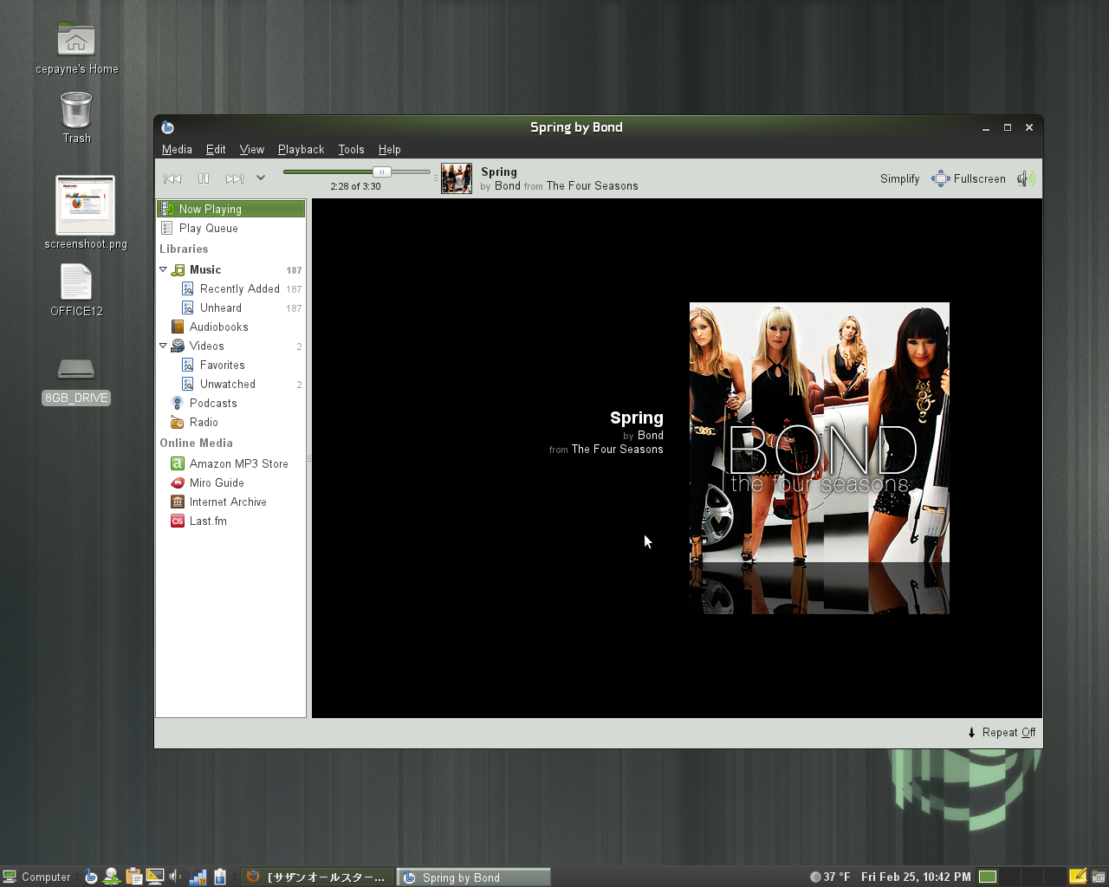
Notes:
Multimedia apps:
Media player Banshee 1.9.3 Now Playing simplify mode, play queue shuffle action, better downloading of cover art, MusicBrainz ID support and improved Last.FM integration. Finally, device support has been improved a lot. Among others, Banshee works more smoothly with the Droid X, Galaxy Portal, Xperia X10, Maemo and MTP devices in general.

Slide 21
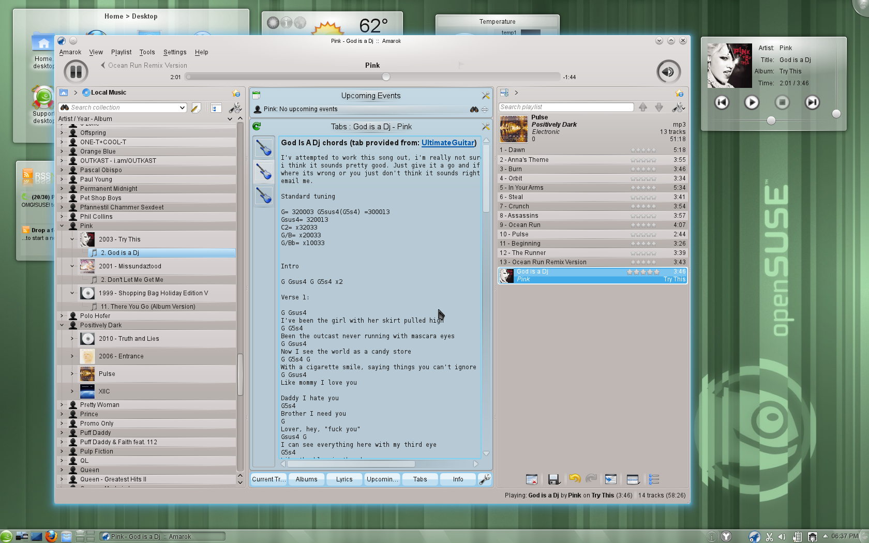
Notes:
Amarok 2.4.0 is faster, write to audio files, MusicBrainz tag retrieval, Guitar and Bass tab fetching, upcoming events, UpnP.
Rhythmbox 0.13.3 “Country Rain”: new context tab showing links to relevant websites with music info.
Clementine: new information panes show lyrics, song statistics, artist biographies, photos and lists of tags and similar artists. added ratings, play counts and skip counts. You can create smart and dynamic playlists from songs in your library, and also now listen to music from Jamendo and Icecast radio stations.
As usual: K3B, Brasero, Audacity and more are in 11.4!

Slide 22
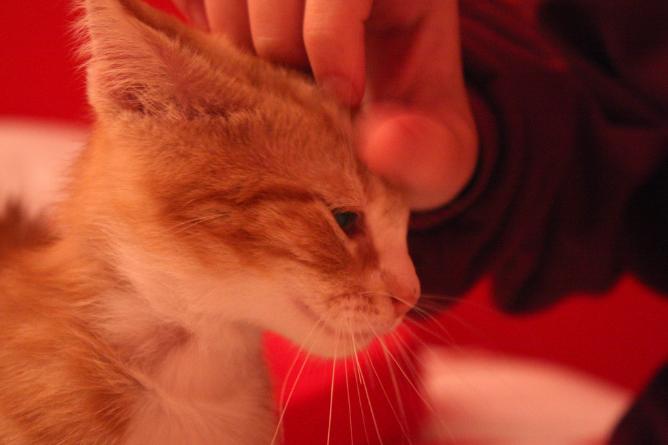
We take good care of sysadmins
Notes:
openSUSE offers everything a sys admin needs to get a server up, a network secured or a HPC workload finished.

Slide 23
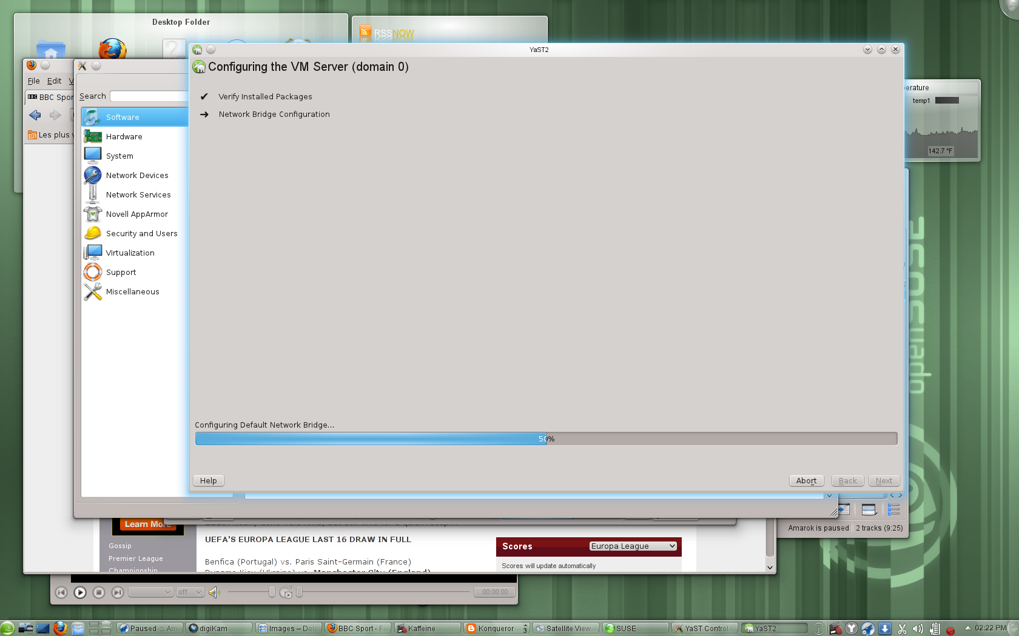
Notes:
openSUSE is great for virtualization. YaST makes management easy!
latest Xen, VirtualBox and KVM and integration with VMware and HyperV.
Xen: memory overcommit, Vmware workstation player/driver
Virtualbox: VMDK, VHD, and Parallels images supported, VHD and VDI can be resized; 32bit systems can use more than 2 GB of ram.
Introduction of open-vm-tools and virtualbox-guest-tools for easier management.

Slide 24

Notes:
YaST was awesome but now: WebYaST! All the power of YaST over a RESTful webservice, easy to use!
Network tools like WireShark 1.4, SMB Trafic Analyzer and everything for webservers:
Apache, lighttpd, Tomcat, nginx
MySQL, PostGRESQL, SQLite, MariaDB
Latest High Availability Clustering tools
New documentation on VMs, tuning etc

Slide 25
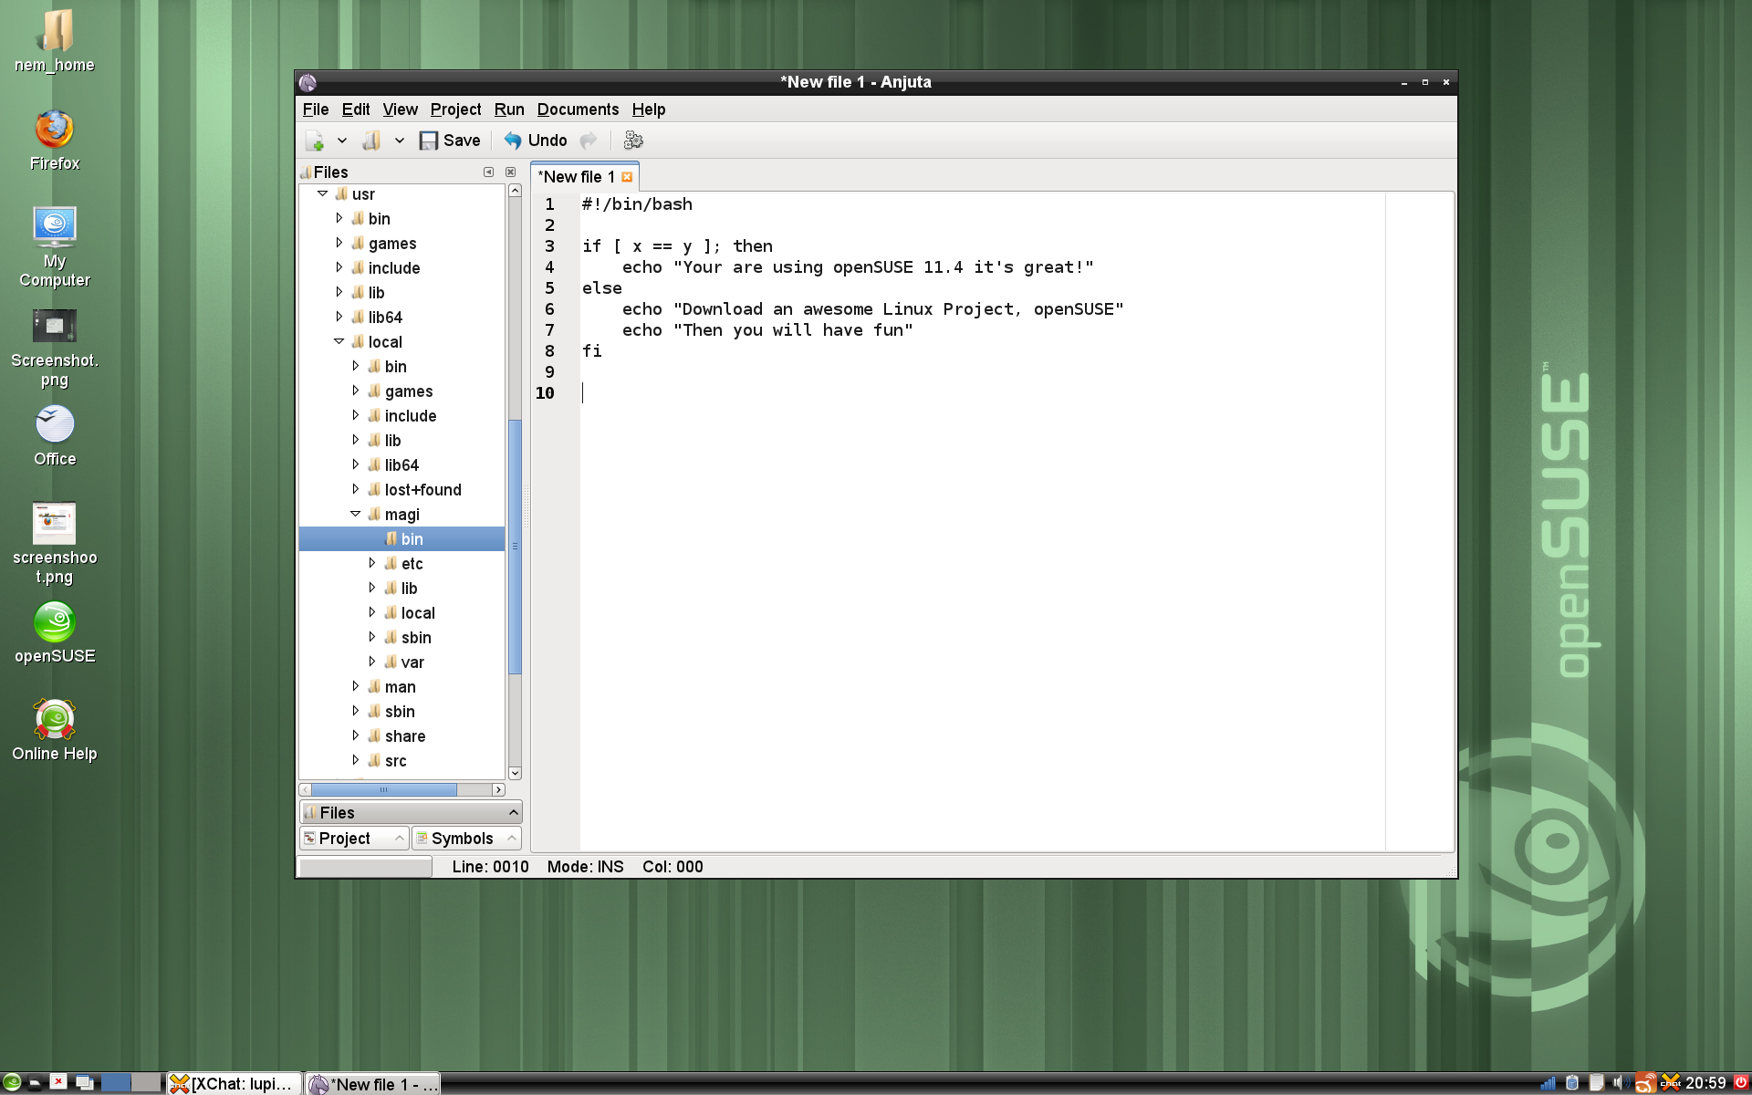
Notes:
OpenSUSE 11.4 is great for developers. We ship pretty much all IDE's (Anjuta, Geany, QtCreator, MonoDevelop, KDevelop, Eric, CodeBeans etc)

Slide 26
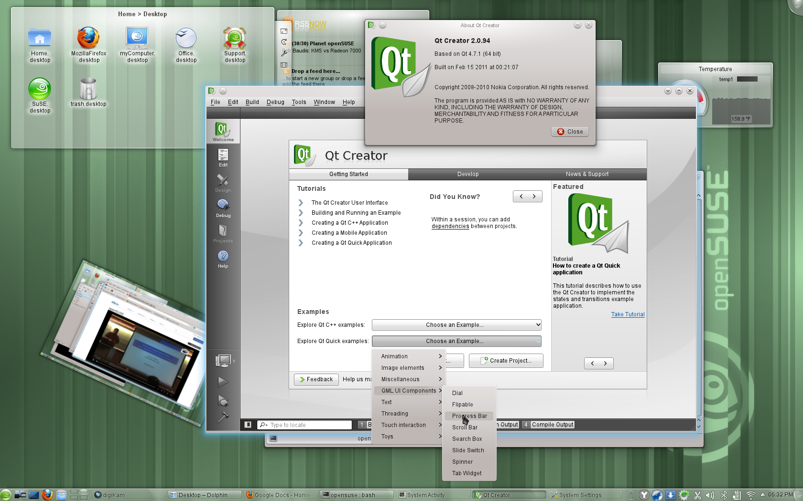
Notes:
We also have the latest KDE & Qt, GNOME 2.x AND 3.x libraries as well as Python, Ruby, Perl, Java and pretty much every other language.

Slide 27

Newcomers welcome
Notes:
You're more than welcome to come check openSUSE out!

Slide 28
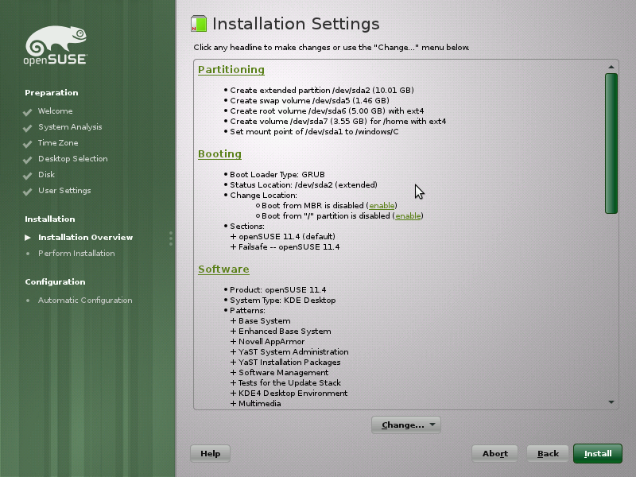
Notes:
openSUSE has a number of Live CD's and DVD's but is also quick and easy to install...

Slide 29
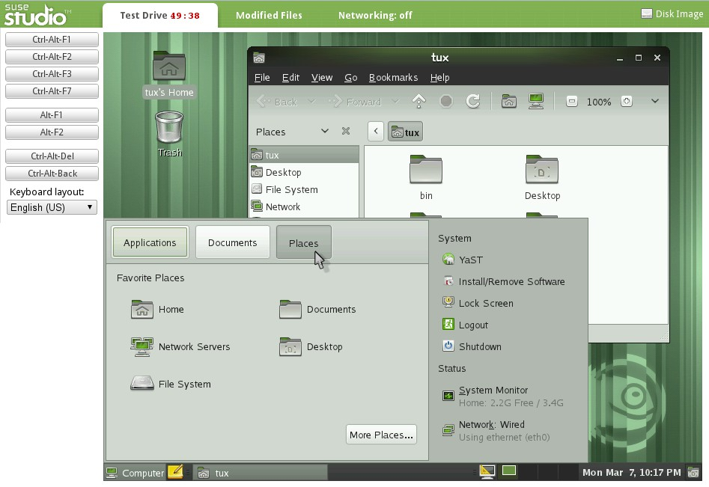
Notes:
If you want an even cooler way of testing, go to SUSEStudio.com and build your own OS and testdrive it directly from your web browser! It is free and easy. Once you're satisfied with the result you can download it as USB or CD live image or one of the VM options!

Slide 30

Be a Geeko/Kitten
Notes:
Be the Geeko you can be!

Slide 31
Kitty and other Image credits
Plasma screenshot: Marco “notmart” martin
Tiling screenshot: Gene Kodadek
Other screenshots: openSUSE marketing team
Take care of sysadmins: sarah ross
Super kitty: malingering
Kittens in box: abcrumly
Be geeko/kitten: no idea...
To be found on Flickr under the above names with a Creative Commons license. Thanks all!

Slide 32
Your next Linux Distribution!
Notes:
So, the question you should be asking is not “what does openSUSE have that I need?” but “what does openSUSE NOT have that I need?” and the answer is most likely: nothing. After all, our OBS provides well over 100.000 different packages made by over 25.000 people. All that you can get easily through Zypper and YaST! Moreover, you can use KIWI (or the web interface SUSE Studio) to build your own openSUSE based operating system. We have projects like Tumbleweed, Appstream and Bretzn – we do so much cool stuff it's hard to keep track of it.
In short, openSUSE is much more than a linux distribution. 11.4 is awesome, but thanks to the other things the openSUSE Project does, no other linux distro can beat it!
Thank you for listening.

Slide 33

opensuse.org
planet.opensuse.org
opensuse.org/Portal:How_to_participate
opensuse.org/Junior_jobs
features.opensuse.org
build.opensuse.org
openhatch.org
#opensuse-project

